Slide 1
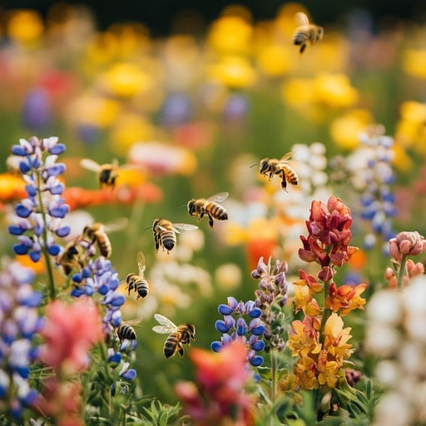
Year 3
Bees
RE
This term we can think deeply about our global church. We explore the teachings and letters of St Paul, which inspire us to help us grow in faith and understanding of the Catholic Social Teaching values for our modern world.
Maths
This term we will be learning about shape, including their properties. We also complete a statistics module allowing us to conduct surveys, complete an analysis of pictograms and bar charts as well as making our own charts and data.
We continue to target our times tables and the corresponding division facts.
Art and Design Tec
Lots of fun to be had researching bees, designing our own mason bee bug hut and making it. We then evaluating the results.
PE
The summer term provides us with a chance to hone our athletic skills ready for sports day.
We will learn various throwing, catching, sprinting and relay skills. We understand what it means to be a good sport and the health benefits of an active lifestyle.
We also learn water safety, swimming 25 meters using a variety of strokes, learning water survival techniques and gaining our water confidence.
French
This term will take us through the second part of our unit Comment t’appelles-tu? moving from introducing ourselves to learning the names and backgrounds of famous French people from across the ages.
Children will explore various historical key figures and gain an introduction to the rich cultural, artistic, scientific and historical contributions of France.
Geography
During geography sessions we will gain an understanding of the environment. We will be using fieldwork to observe, measure, and record human and the physical features or our local area.
Science
This term the focus is on the environment and ecology. We explore pollination and the various parts of a plant, as well as considering how we can be thinking about caring for our local and global environment. We conduct experiments to consider what makes a plant grow successfully.
We also complete a module of light and explore lights key properties and characteristics.
English
Reading several bee related books we explore closely how we can add directed speech into our own writing. Create written instructions for others to follow and creating non-chronological reports about bees.
This term we also visit Wildwood and explore various creatures associated with the British Isles.
Music
To understand concepts of duration, beat and rhythm, time signatures and note values including crotchets, minims and quavers. We continue to learn to play tuned percussion instrument. Introducing B, A and G and add notes E, D and C as a process.

